Slide 1
IT1102
Computer Hardware
Week 2
Organizing and managing files and folders

Slide 2
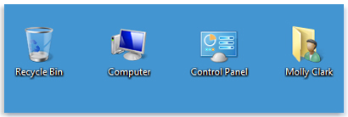
Desktop
The desktop is the main screen area that user see after turn on computer and log on to Windows
user can store files and folders or short cuts in it , and arrange them as user want

Slide 3
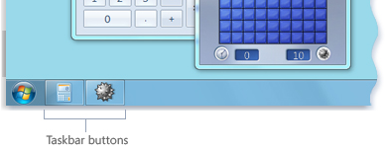
Taskbar
Taskbar sits at the bottom of your screen
It shows user which programs are running
It allows user to switch between running programs
User can also use Alt + Tab to switch between running programs

Slide 4
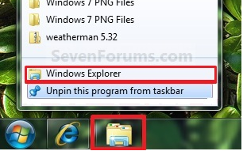
Windows Explorer
Windows Explorer in early Windows versions
File Explorer in Windows 8
File Explorer is a file manager application allows you to open, access, and rearrange your files and folders.
It provides a graphical user interface for accessing the file systems.
Windows key + E

Slide 5
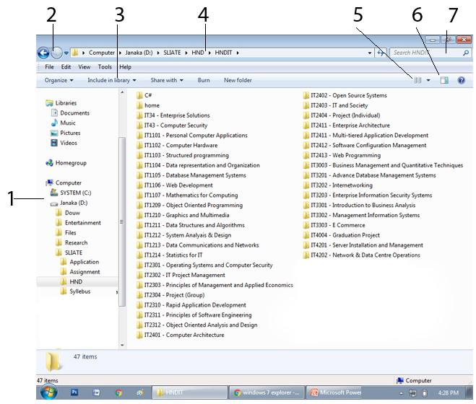

Slide 6
Navigation pane
  Hierarchically expand the computer to browse folders and subfolders.
Back and Forward buttons
  Navigate to other folders or libraries user have already visited
Toolbar
  command icons to perform common tasks, such as changing the appearance of your files and folders, burning files to a CD, or starting a digital picture slide show. The toolbar's buttons change to show only the tasks that are relevant.

Slide 7
Address bar
  Show the current folder path
  To navigate to a different folder or library
View button
  Use to change how the files in the file list are organized. (order or group)
Preview button
  show or hide the selected item (e‑mail message, text file, or picture.)
Search box
  To search for an item by typing the name

Slide 8
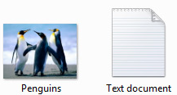
File
A file is an item that contains information
Text, images, video or music
Graphically represented by an icon

Slide 9
File Extension
Two, three or four characters followed by period
Helps identify the type of file
Common file type in Windows
  .AVI Multimedia Audio/Video
  .BAT PC batch file
  .BMP Windows BitMap
  .DOC Microsoft Word for Windows/Word97
  .EXE PC Application
  .GIF Graphics Interchange Format
  .JAVA Java files

Slide 10
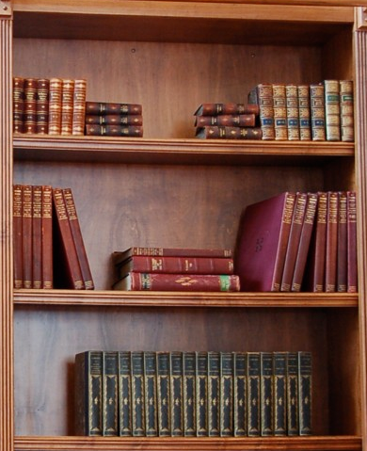

Organizing files
Why?
  Easy to store
  Easy to find

Slide 11
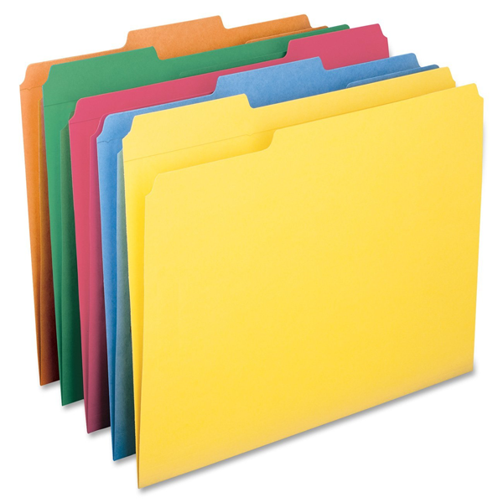
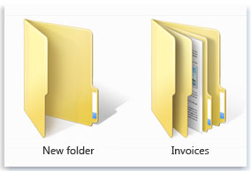
Folder
Folder is a container used to store files

Slide 12

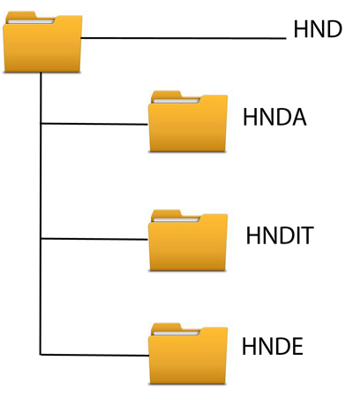
Folder
Folders can also store other folders
folder within a folder is called a subfolder
Folders are arranged in hierarchal structure

Slide 13
File or folder path
Specifies a unique location in a file system.

Slide 14
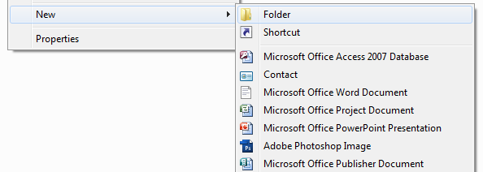
Creating new file or folder
Right-click a blank area on the desktop or in the folder window, point to New, and then click Folder of require file type .
Type a name for the new folder of file, and then press Enter.

Slide 15
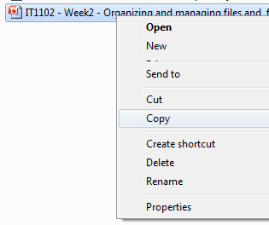

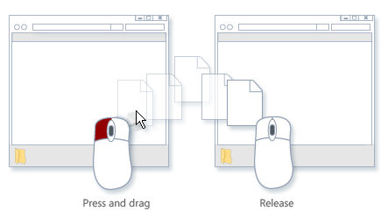
File and folder operations
Copy and past
Cut and pats
Delete
Rename
Drag and drop

Slide 16

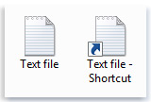
Short cuts
A shortcut is a link to an item (such as a file, folder, or app) on your PC.
user can easily access the item that the shortcut links to.
Shortcuts can be distinguished from the original file by the arrow that appears over-layed on the icon
Adding short cuts to desktop
  Right-click the item
  click Send to
  then click Desktop (create shortcut).
  The shortcut icon appears on your desktop.

Slide 17

Recycle Bin
Temporary storage to store the deleting files from the file manager (Windows explorer)
When user deleting files they are automatically moving to Recycle Bin, and do not delete permanently from the storage.
Items in the Recycle Bin remain there until permanently deleted by user
User can bypass Recycle Bin by using Shift + Del

Slide 18
Recycle Bin
Windows allocates one Recycle Bin for each partition or hard disk
By default Windows allocates 10% for each Recycle Bin in each partition

Slide 19
Default libraries
Documents library.
  To organize and arrange word-processing documents, spreadsheets, presentations, and other text-related files.
  By default, files that you move, copy, or save to the Documents library are stored in the My Documents folder.
Pictures library.
  To organize and arrange your pictures, get them from camera, scanner, or in e‑mail.
  By default, files that you move, copy, or save to the Pictures library are stored in the My Pictures folder.

Slide 20
Default libraries
Music library.
  To organize and arrange your music.
  By default, files that you move, copy, or save to the Music library are stored in the My Music folder.
Videos library.
  To organize and arrange videos, such as clips from digital camera or camcorder, or video files that download from the Internet.

